Slide 1
Compyle Form Sections
Organizing fields, improving layout, and building up to form logic
November 2023

Slide 2
Introduction & Welcome
Thank you to our customers, beta users, & staff who have all provided feedback that we are using to make Compyle even better.
Please send future feature suggestions to the Compyle, Control, & Scorecard support team at support@clearimpact.com.

Slide 3
Agenda: Upgrade Overview
Introduction:
Data Organization
Improved Data Entry & Form Editing
Foundations for Form Logic
Form Sections
Survey Forms & Note Type Forms
Edit Surveys/Notes (save buttons, reorder fields)
Data Entry for Survey Forms & Note Forms
Printing the forms
User Interface (UI)
Edit Participant/Organization Fields
Edit Public Forms
Refinements & Repairs
Filter history – clear filters button
Import Phone Number preview
Delete new field warning
Number Fields (data entry & display)
What’s Next
2023: Form Logic – development starts next week
Roadmap for 2024
Conclusion
Resources & Reminders
Questions & Answers

Slide 4
Simplicity through Structure
Sections:
act as containers for groups of related fields
help organize information
break up the monotony of a long form
provide more options for managing how information is presented
Future plans:
As we develop skip logic for Compyle forms later this year, having sections will allow for rules to be applied to groups of fields instead of only on a field-by-field basis.

Slide 5
Form Sections: Survey Forms & Note Forms

Slide 6
Creating & Editing Surveys
Form Section Properties
Section names can be changed
Default setting – expanded or collapsed
Hidden (will be more useful with logic rules)
Fields can be moved to other sections, but sections cannot be reordered yet
Sections can only be deleted if all fields—active, hidden, inactive—have been removed.
Layout changes
Blue background for each section
Save buttons after each section
Add new field and add existing field buttons repeated for each section
New sections & new field order will only appear on newly started instances. As with new fields, new sections do not affect existing instances.
Benefits: Cleaner, easier to navigate

Slide 7
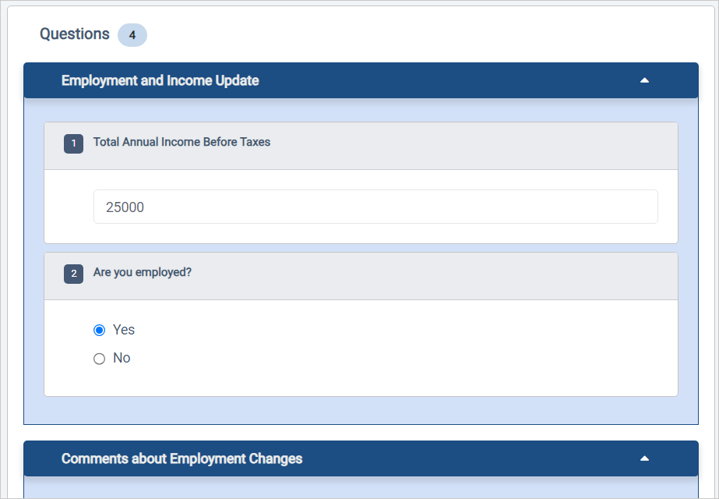
Data Entry with Form Sections
Sections now display when you fill out survey responses in Compyle as a user or as a participant working on a large device.
On mobile devices, sections only show if the desktop mode is activated by the user.
Sections appear in Print Form for survey forms and note forms.
Exceptions
Multi-entry forms do not have sections
The survey instance question view does not show sections.
Export data does not include section titles

Slide 8
User Interface(UI) Improvements

Slide 9
New Color Elements
Customer Requested Feature Enhancement
Users from a doula/birth worker organization, which works to increase perinatal equity for families of color, requested that we improve Compyle’s interface. They shared that the monotonous gray on gray color scheme is not conducive to working in the system all day. We listened, heard, and understood where they are coming from.
Benefits: Compyle forms are, hopefully, easier to look at, easier to read, and perhaps more welcoming.

Slide 10
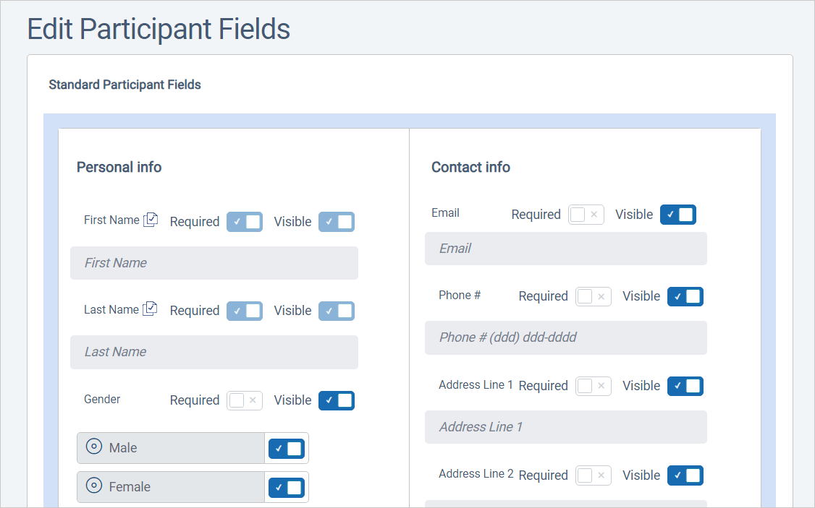
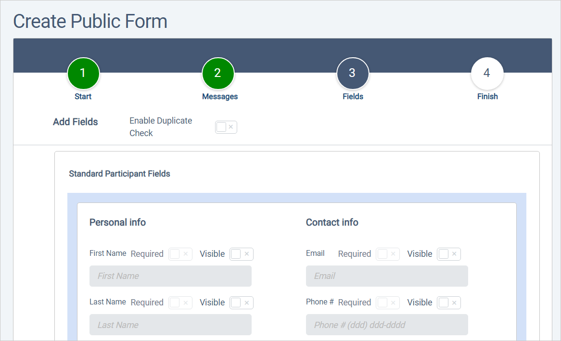
Other Layout Changes
Editing Forms:
Participant Form Fields, Organization Form Fields, Anonymous Form Fields
Sections clearly labeled for standard and custom fields
Blue background for each section
Public forms have similar display
Not Yet Changing
Data entry for Participants, Organizations, & Anonymous forms
Data entry for the Public Form versions of those forms

Slide 11
Refinements & Repairs

Slide 12
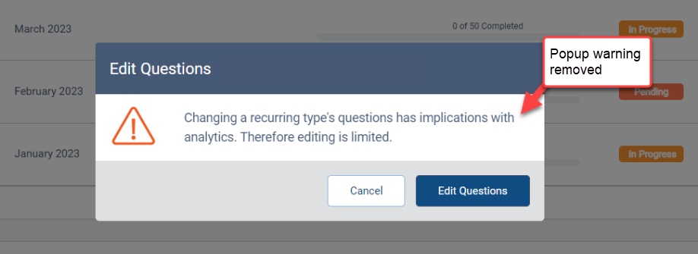
Various Improvements
Better navigation:
Removed the popup warning when editing Survey Form fields
Fixed filter history so clear filters button appears for active group assignment filters
Behind the scenes changes to help reduce unexpected blank screen
More clear
Import Phone Number preview corrected
Updated wording when deleting new field options
Delete new field for warning removed
Benefit: Things work better so users are happier and can more easily do what they need to do

Slide 13
Conclusion & Future Endeavors

Slide 14
Conclusion
Sections are a visual change for improved data entry and form design experiences. They are another layer of functionality added to support logic and rules within forms.
What’s next: Skip Logic Form Rules (rules that apply within a form to conditionally show/hide/require fields and expand/collapse sections).
The next release is going to be worked on in smaller, more contained “sprints” as a single form logic rule can have broad effects.
That means we will develop a key function, test it with all the field types in each of the data entry modes with all supported browsers and devices.
Then we will release it or add a new function and retest. This may result In a series of smaller more focused releases.

Slide 15
Roadmap: Logic Levels
 | Skip Logic | Workflow Logic
Development Starts | By end of 2023 | 2024
Admin Created Rules | Yes | Yes
Affects Forms | Single Survey/Note Form | Multiple Forms
Field Entries Determine | Required fields, visible fields, sections & pages available | Workflow enrollment
Rules Apply | When survey response is being completed | When various trigger actions occur
Group Assignments | No | Yes
User Notifications | No | Yes
Navigation Within One Form | Yes | Not Sure yet
Navigation Across Forms | No | Yes
This month, we start development for Skip Logic Form Rules.
We are also starting to gather requirements for Workflow Logic Process Rules to automate client and user management for 2024.
Here is how they differ.

Slide 16
Resources & Reminders
Documentation
Release Notes: https://support.clearimpact.com/en/compyle-release-notes-sections-for-survey-forms-and-note-forms-nov.-2023
Compyle Design: Field Types: pictures of field types in edit mode and entry mode: https://support.clearimpact.com/en/compyle-implementation-field-types
Upcoming Customer Webinars
Scorecard:
Nov. 30th: Upgrade Summary
Dec. 7th: Upgrade Summary
Suite:
Dec 14th: Learn with Us - Prep for End of Calendar Year Reporting
More Clear Impact Events
RBA Certification BOGO:
Nov. 6th – Dec. 31st
Social Sector Hero Book Tour:
Nov. 15th: Austin, TX
Nov. 17th: San Antonio, TX
2024: Open for bookings (No speaker fee)

Slide 17
Q & A
Any questions?

